Slide 1
Spring Boot

Slide 2
Introduction to Spring Boot
Spring Boot is a project that is built on top of the Spring Framework.
It is a Spring module that provides the RAD (Rapid Application Development) feature
It provides an easier and faster way to set up, configure, and run both simple and web-based applications.
Spring Boot is a microservice-based framework
An open-source Java-based framework used to create standalone microservices with production-ready features.
Microservice is an architectural design that creates
scalable, loosely coupled, and testable applications which have a single function module with well- defined interfaces.
The microservices can be owned and maintained by a small team and is adapted in an Agile manner

Slide 3
Difference between Spring and Spring Boot
 | Spring | Spring Boot
What is it? | An open-source web application framework based on Java. | An extension or module built on the Spring framework.
What does it do? | Provides a flexible, completely configurable environment using tools and libraries of prebuilt code to create customized, loosely coupled web apps. | Provides the ability to create, standalone Spring applications that can just run immediately without the need for annotations, XML configuration, or writing lots of additional code.
When should I use it? | Use Spring when we want: Flexibility An unopinionated approach. To remove dependencies from your custom code. To implement a very unique configuration. To develop enterprise applications. | Use Spring Boot when we want: Ease of use An opinionated approach. To get quality apps running quickly and reduce development time. To avoid writing boilerplate code or configuring XML. To develop REST APIs.
What's its key feature? | Dependency injection | Autoconfiguration
Does it have embedded servers? | No. In Spring, you'll need to set up the servers explicitly. | Yes, Spring Boot comes with built-in HTTP servers like Tomcat and Jetty.
How is it configured? | The Spring framework provides flexibility, but its configuration has to be built manually. | Spring Boot configures Spring and other third-party frameworks automatically by the default "convention over configuration" principle.
Do I need to know how to work with XML? | In Spring, knowledge of XML configuration is required. | Spring Boot does not require XML configuration.
Are there CLI tools for dev/testing apps? | The Spring framework alone doesn't provide CLI tools for developing or testing apps. | As a Spring module, Spring Boot has a CLI tool for developing and testing Spring-based apps.
Does it work from an opinionated or unopinionated approach? | Unopinionated | Opinionated

Slide 4
What is dependency injection?
Dependency injection (DI) is a design technique used to achieve inversion of control (IoC).
In object-oriented programming like Java, objects that depend on other objects are called dependencies.
Typically, the receiving or dependent object is called a client and the object that the client is dependent on is called a service.
So, dependency injection passes the service to the client, or "injects" the dependency using code called an injector.
DI eliminates the need for the client to specify which service to use—the injector does that work for the client.

Slide 5
Features of Spring Boot
Web Development
It is well suited Spring module for web application development. We can easily create a self-contained HTTP server using embedded Tomcat, Jetty or Undertow. We can use the spring-boot- starter-web module to start and running application quickly.
SpringApplication
It is a class which provides the convenient way to bootstrap a spring application which can be started from main method. You can call start your application just by calling a static run() method.
Application Events and Listeners
Spring Boot uses events to handle variety of tasks. It allows us to create factories file that are used to add listeners. we can refer it by using ApplicationListener key.
Always create factories file in META-INF folder like: META-INF/spring.factories
Admin Support
Spring Boot provides the facility to enable admin related features for the application. It is used to access and manage application remotely. We can enable it by simply using spring.application.admin.enabled property.
Externalized Configuration
Spring Boot allows us to externalize our configuration so that we can work with the same application in different environments. Application use YAML files to externalize configuration.

Slide 6
Features of Spring Boot
Properties Files
Spring Boot provides rich set of Application Properties. So, we can use that in properties file of our project. Properties file is used to set properties like: server-port = 8082 and many others. It helps to organize application properties.
YAML Support
It provides convenient way for specifying hierarchical configuration. It is a superset of JSON. The SpringApplication class automatically support YAML. It is successful alternative of properties.
Type-safe Configuration
Strong type-safe configuration is provided to govern and validate the configuration of application. Application configuration is always a crucial task which should be type-safe. We can also use annotation provided by this library.
Logging
Spring Boot uses Common logging for all internal logging. Logging dependencies are managed by default. We should not change logging dependencies, if there is no required customization is needed.
Security
Spring Boot applications are spring bases web applications. So, it is secure by default with basic authentication on all HTTP endpoints. A rich set of Endpoints are available for develop a secure Spring Boot application.

Slide 7
Advantages of Spring Boot
Spring Boot works well with several servlet containers
Spring Boot works well with some of the most popular embedded servlet containers.
Spring Boot uses Tomcat as its default.
Bootstrapping saves memory space
Spring Boot uses Boot Initializer to compile the source language.
This bootstrapping technique makes it possible for users to save space on their devices and load applications quickly.
Decreased boilerplate code
Spring Boot’s in-memory database and embedded server (Tomcat) decrease or eliminate the boilerplate code typically needed to set up an application.
No XML configuration required
WAR files are not required
Spring Boot can rely on JAR (Java resource). It may use WAR (web application resource) files, they are not necessary
POM dependency management
Spring Boot doesn’t force to use a parent POM (project object model).
Adding the spring-boot-dependencies artifact will manage dependencies without relying on a parent POM or XML file..
A large community of helpful users
Spring Boot has a large community of users full of people who enjoy sharing their insights and creations.

Slide 8
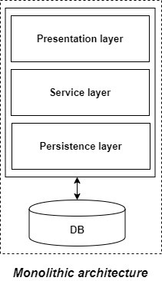
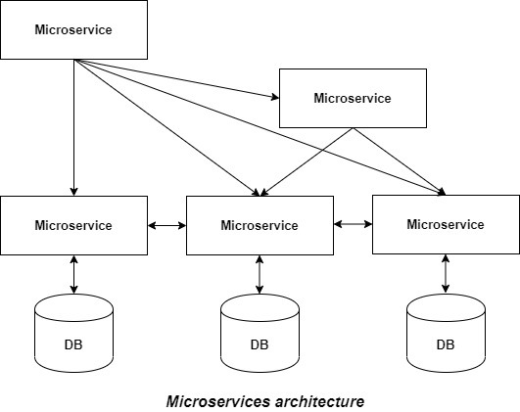
Breaking the monolithic way of developing software
Monolithic architecture
In monolithic application, “mono” represents the single codebase containing all the required functionalities
If all the functionalities of a project exist in a single codebase, then that application is known as a monolithic application.
As an example, if we are given a problem statement and were asked to design a system with various functionalities.
The entire application is tested and deployed at once
Micro Services
It is an architectural development style
The application is made up of smaller services
Each service can have a single functionality, single data repository.
Each service is independent of each other so that the change in one service doesn’t impact the whole application.
Each service can communicate with each other using Inter Process Communication (IPC) calls via web services/APIs.
Each service can be tested independently
Deploying each application independently in an isolated environment which can share different external services.

Slide 9
Micro Services contd..
When to use micro services?
Migrate legacy applications to the new technology
Changing technology stack for one service would not affect the whole application.
Create high-performance and scalable services which only serves the single purpose that requires high computation/memory/resources.
Experiment with the Agile methodology where requirements come in periodic intervals and the same can be delivered in a short span of time unlike monolithic where all the bundles are installed at once.
When not to use micro services?
Cost increased since each microservice runs in isolated virtual machines.
If the development team is of small size, then it must manage all independent small size services which may lead to big changes in the capacity and productivity of the team.
This can put a strain on all the operating units and the developers of that particular service.
If the requirement is that tiny, then it cannot be further broken into different service creations.
Some support of tools in legacy applications may not be supported in the microservice architecture because of tool limitation.

Slide 10
System requirements
Tool | Version
Java | 17 and higher
Apache Maven Gradle | 3.3 and higher 6.3 and higher
Spring Tool Suite | 3.9.4.RELEASE and higher
Eclipse | EE and Web Developers

Slide 11
The 12-factor app
Any developer, who builds the application that runs as a service, should incorporate the 12-factors in their application
I. Codebase
One codebase tracked in revision control, many deploys
II. Dependencies
Explicitly declare and isolate dependencies
III. Config
Store config in the environment
IV. Backing services
Treat backing services as attached resources
V. Build, release, run
Strictly separate build and run stages
VI. Processes
Execute the app as one or more stateless processes
VII. Port binding
Export services via port binding
VIII. Concurrency
Scale out via the process model
IX. Disposability
Maximize robustness with fast startup and graceful shutdown
X. Dev/prod parity
Keep development, staging, and production as similar as possible
XI. Logs
Treat logs as event streams
XII. Admin processes
Run admin/management tasks as one-off processes

Slide 12
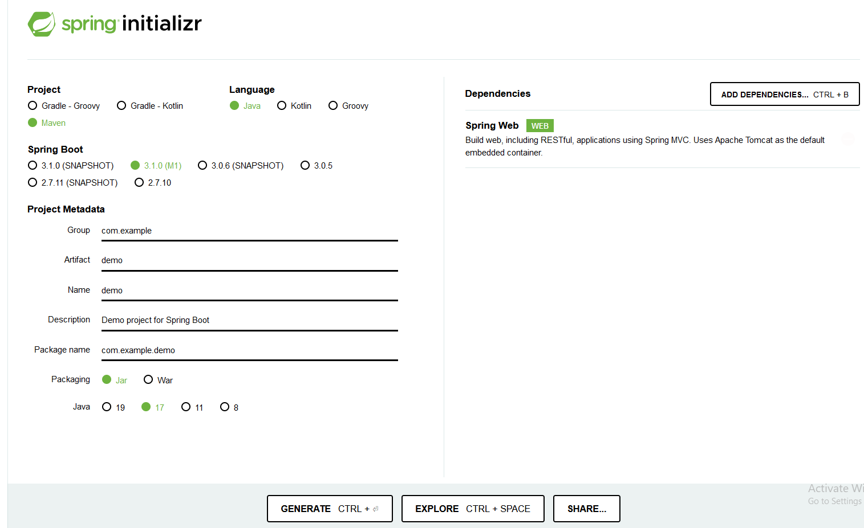
Spring Initializr
One of the best ways to create a Spring Boot application is to generate the skeleton project from Spring Initializr
https://start.spring.io/

Slide 13
Build Tools- Maven
Need of Build Tools:
For building heavy projects, there is a need of segregating codes into components so that they can be reused again within the same project or by other projects.
Here, the project is the build module for an application.
For using these components in the project, need to add components into our classpath so that our project gets these components and the build is successful.
To add the components to classpath, there are build tools available on the Internet
The famous build tools are Maven and Gradle.
Maven:
Maven is the project management build tool developed by Apache Org which adds the functionalities of Java libraries through dependencies.
Maven is a stage-driven build tool and its lifecycle is divided into stages such as validate, compile, test, package, verify, install, and deploy.
Developers can create their own dependencies for the purpose of modularity.
They can also use the dependencies stored in the repository.
The core component of the Maven project is pom.xml.

Slide 14
Understanding the entry point class
package com.author.kickstart;
import org.springframework.boot.SpringApplication;
import org.springframework.boot.autoconfigure.SpringBootApplication;
@SpringBootApplication
public class KickstartApplication {
public static void main(String[] args) { SpringApplication.run(KickstartApplication.class, args);
}
}
The main function of the class is calling the run function of the SpringApplication class
When this is called during runtime, it loads all the dependencies

Slide 15
SpringBootApplication annotation
The @SpringBootApplication annotation describes the class where it is used in a Spring Boot application.
This annotation is a combination of the following annotations:
@SpringBootConfiguration : allow to register extra beans in the context or import additional configuration classes
@EnableAutoConfiguration: enable Spring Boot’s auto-configuration mechanism
@ComponentScan: enable @Component scan on the package where the application is located

Slide 16
Program
import org.springframework.boot.SpringApplication;
import org.springframework.boot.autoconfigure.SpringBootApplication;
@SpringBootApplication
public class LearnSpringBootApplication {
public static void main(String[] args) { SpringApplication.run(LearnSpringBootApplication.class, args);
}}
import org.springframework.web.bind.annotation.RequestMapping;
import org.springframework.web.bind.annotation.RestController;
@RestController
public class CourseController
{
@RequestMapping("/courses")
public List<Course> retrieveAllCourses()
{
return Arrays.asList(
new Course(1, "Learn AWS", "in28minutes"),
new Course(2, "Learn DevOps", "in28minutes"),
new Course(3, "Learn Azure", "in28minutes"), new Course(4, "Learn GCP", "in28minutes"));
}
}
public class Course {
private long id;
private String name;
private String author;
public Course(long id, String name, String author) {
super();
this.id = id;
this.name = name;
this.author = author;}
public long getId() {return id;}
public String getName() {return name;}
public String getAuthor() {return author;}
@Override
public String toString() {
return "Course [id=" + id + ", name=" + name + ", author=" + author + "]"; }
}

